Slide 1


Confessionity
your Anonymity, our Responsibility

Slide 2

Submitted By -
Prof. Rajesh
Mishra
Manjima
Chaterjee
Diganta
Biswas
Guide
Roll - 203224-21-0120
Roll - 203224-21-0120
Submitted For B.Sc. Semester - VI (Honours) Examination 2023, (Under CBCS)
Dept. o Computer Science, Seth anandram Jaipuria College,
The University of Calcutta

Slide 3

Content.
01
04
Domain Description
Methodology
02
05
Motivation
Implementation
03
06
Scope
Future Scopes

Slide 4


01
Domain Description
Insert image here
Animation: Fade – With Previous
Confessionity is a web based social media platform developed in React, Node.js, Express and MongoDB
This website enables login and registration facility to the users
Users can confess on this platform being completely anonymous
Users can advice and suggest on others confessions

Slide 5


02
Motivation Of Project
Insert image here
Animation: Fade – With Previous
To create a platform where users can get a relief of their deed
To avoid depression which is significantly growing among this so called Gen-Z generation
Users will not have to worry about their identity, it is completely anonymous
Users can create particular group for his/her benefit of topic or matter

Slide 6

03
Scope Of The Project
Users can create their own account and post their confession.
They can also comment on others confession on what they should do next.
Users can create a specific group of his/her choice which wil contain confessions of similar topic
If any user tries to insult any user or uses foul languages, the user is not allowed to post it until it matches our standards.
The username is auto-generated so that no one can guess any users’ identity based on their personal username choices.

Slide 7
Methodology
04

Slide 8
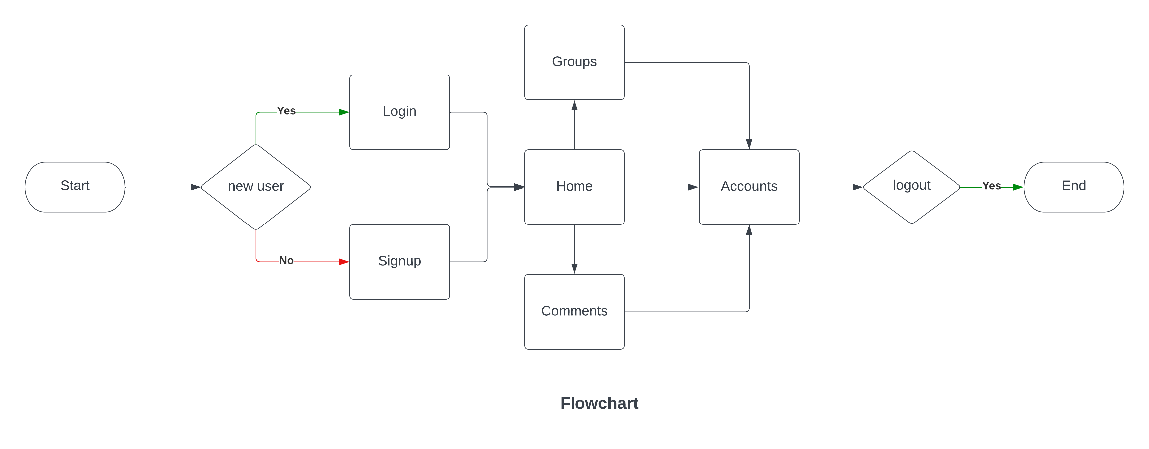


Slide 9
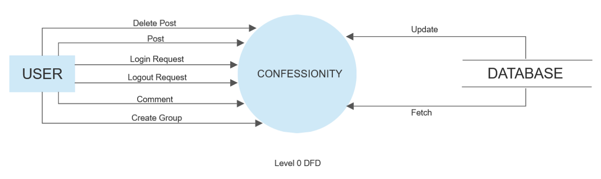

Slide 10
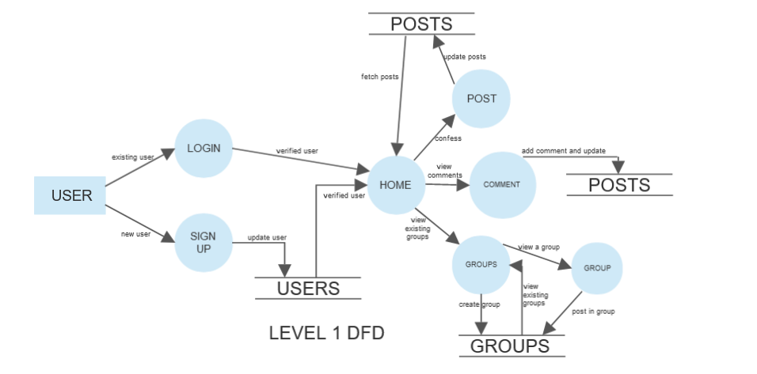

Slide 11
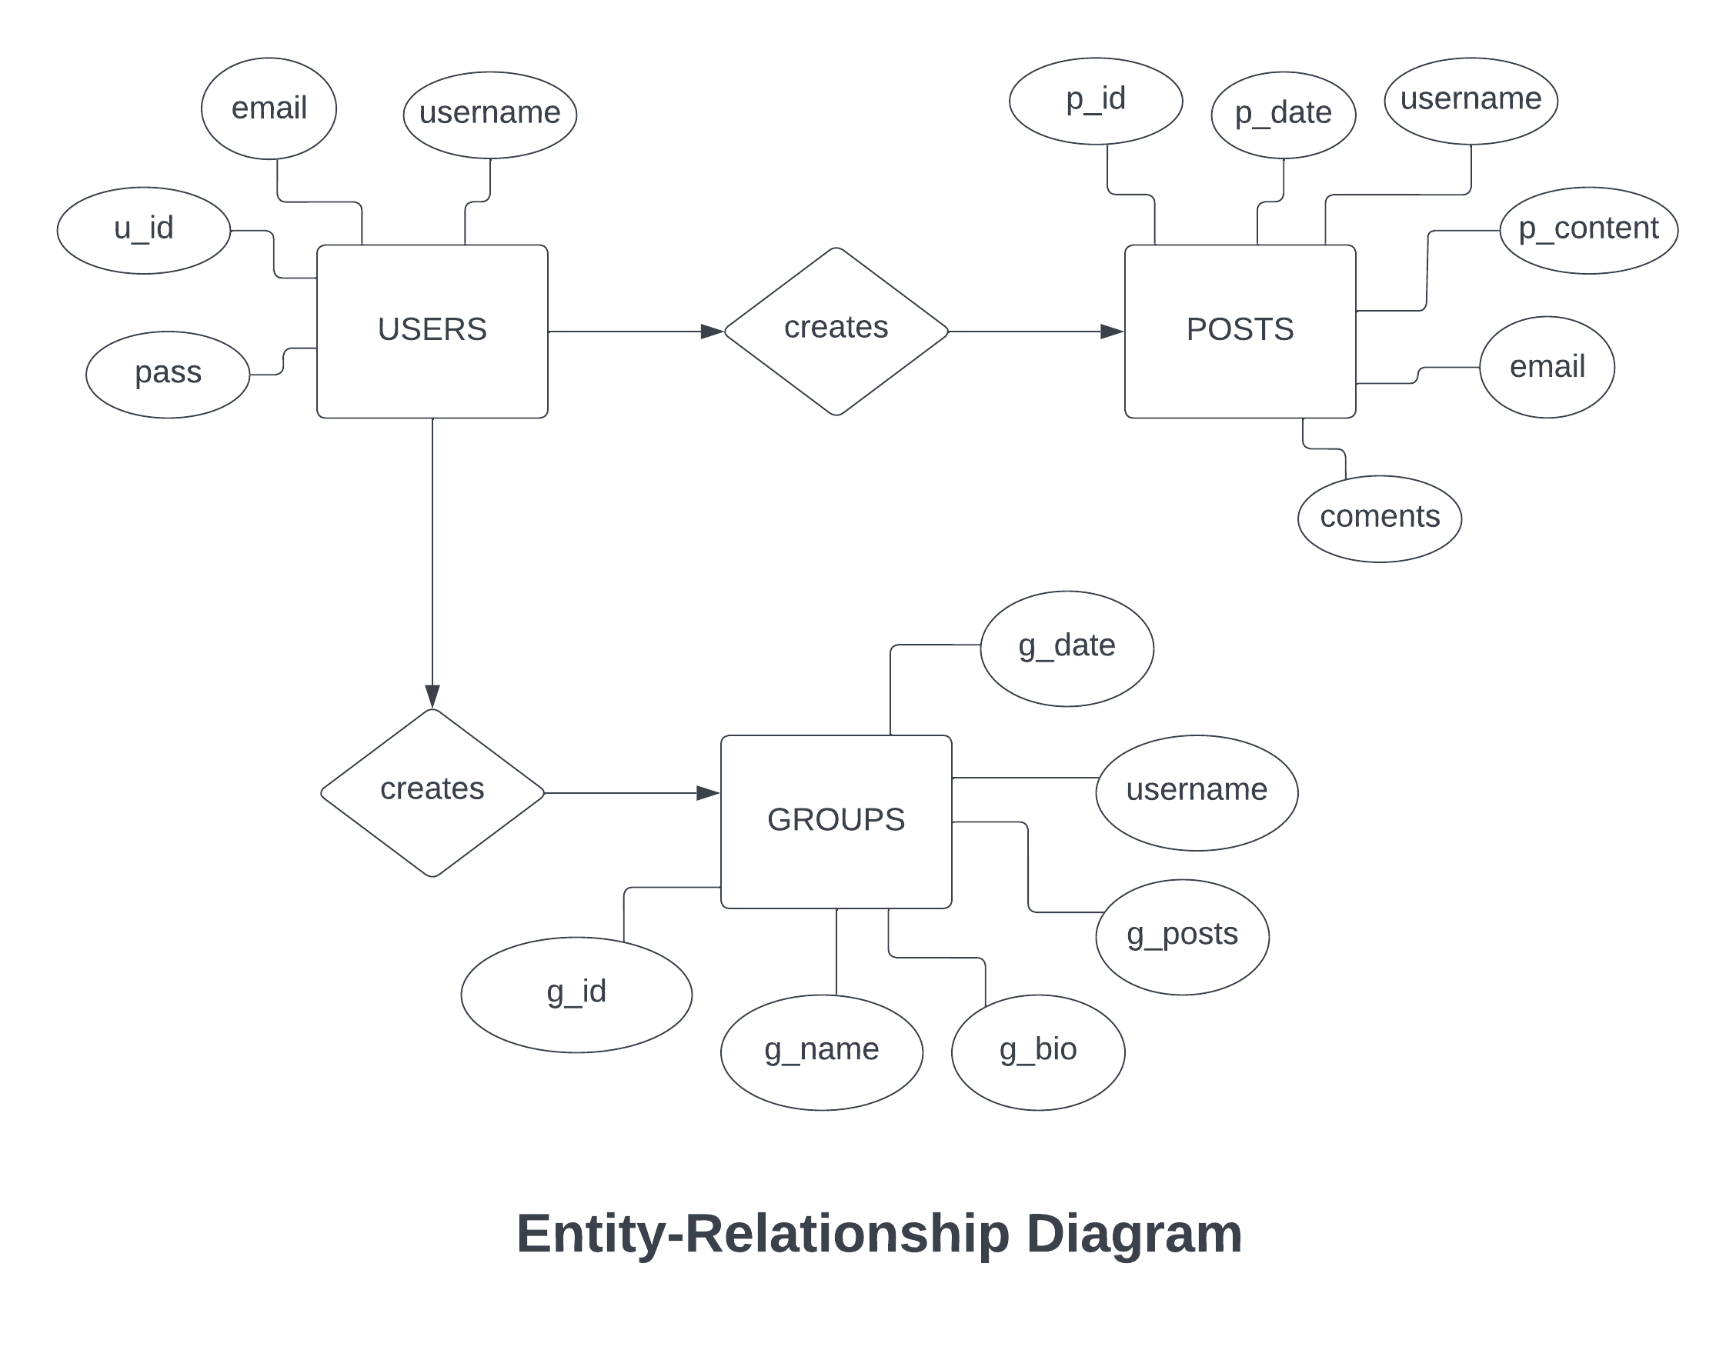

Slide 12

05
Implementation
The client-side is designed in React and Material UI (MUI) and Nodejs and Express for the server-side development.
Github is used for version control for this project.
This is a simple website built throughout to provide users with advices and suggestions on something they have done, anonymously.
Browsers communicate with servers using protocols, which are a set of instructions.
Click Here For The Complete Source Code -

Slide 13
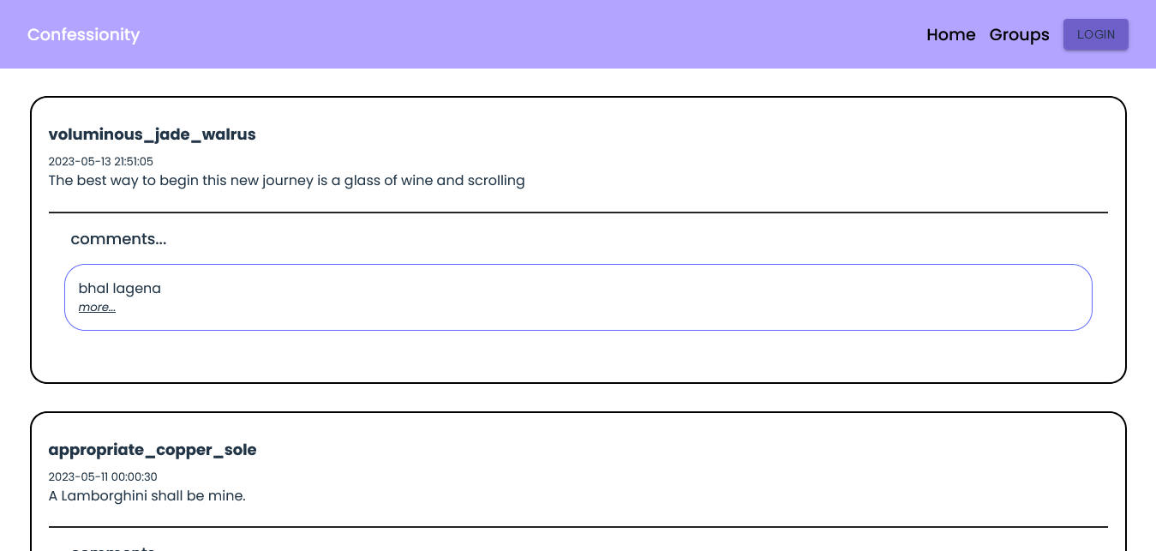
Home page when the user is logged out

Slide 14
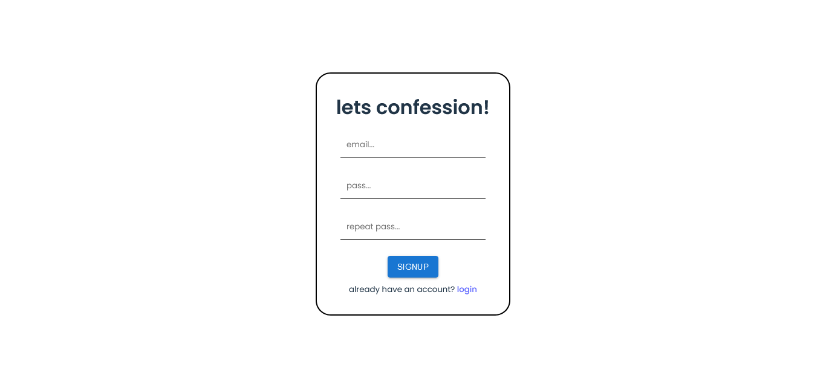
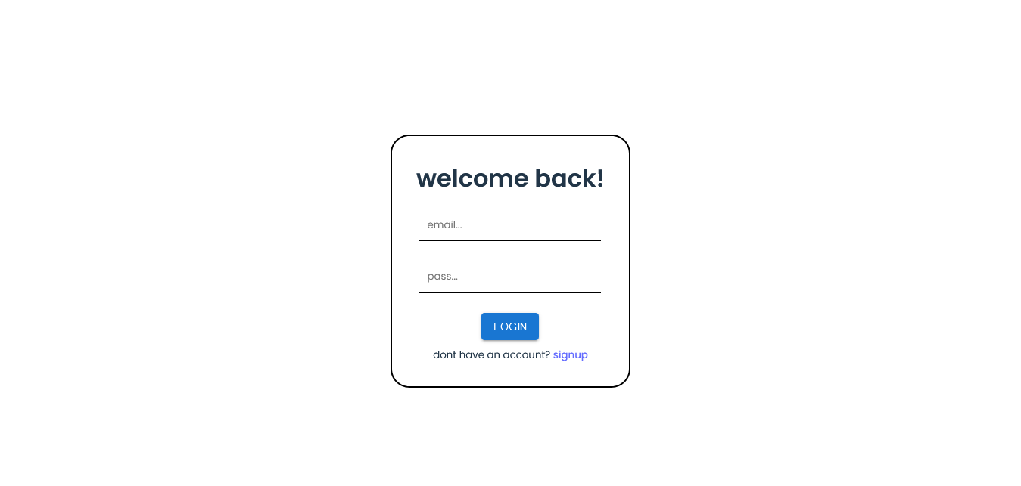
login and signup pages - users can create or login to their account

Slide 15
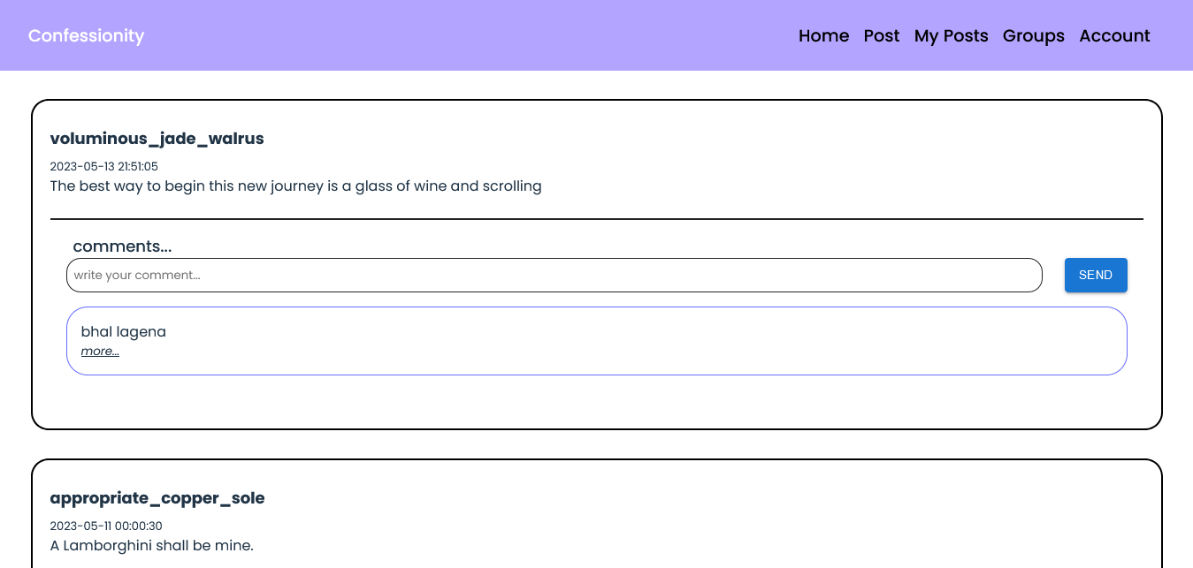
Home page when the user is logged in - can see what others have posted

Slide 16
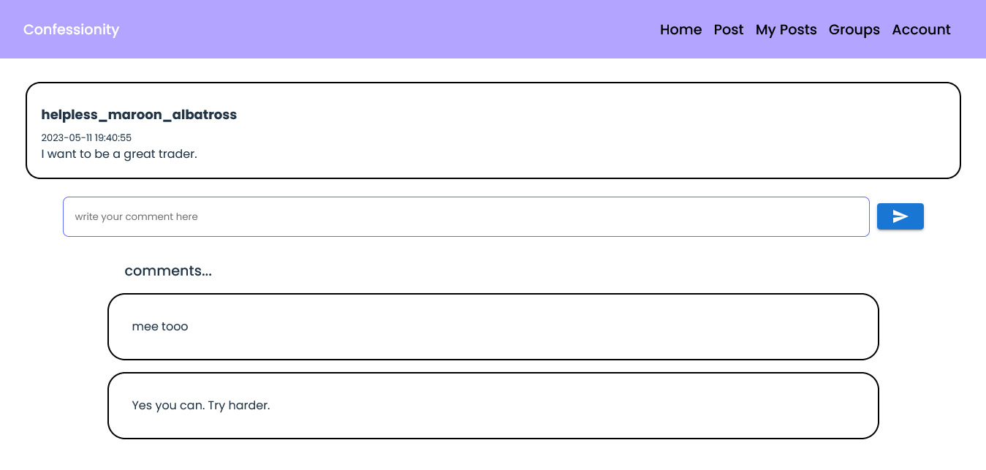
Comments page - users can view and comments here

Slide 17
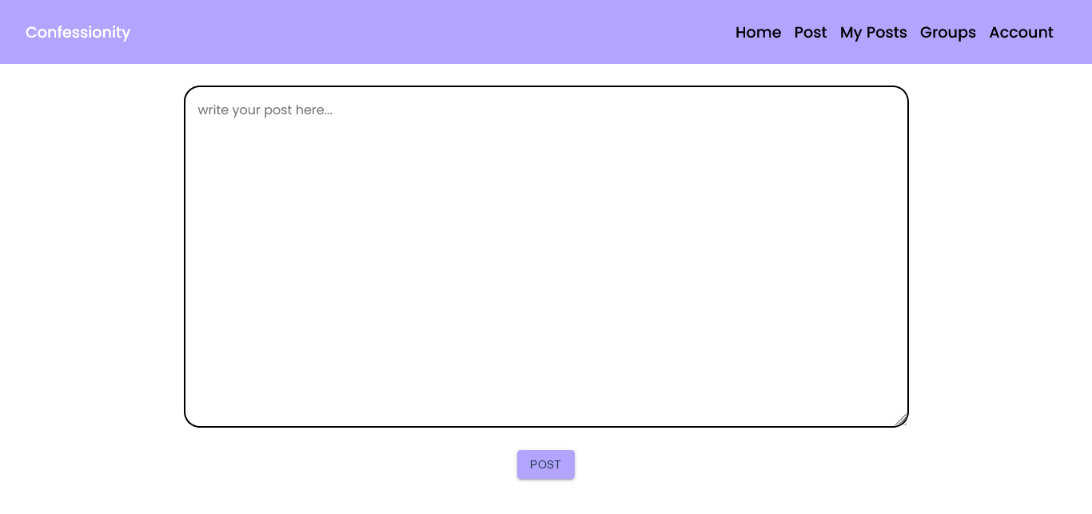
Post page - user can confess from here

Slide 18
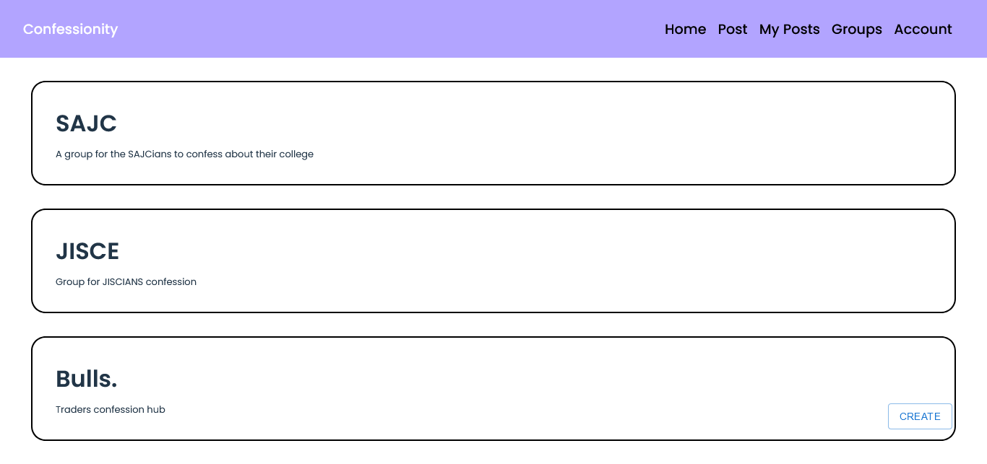
Groups page - users can view the existing groups

Slide 19
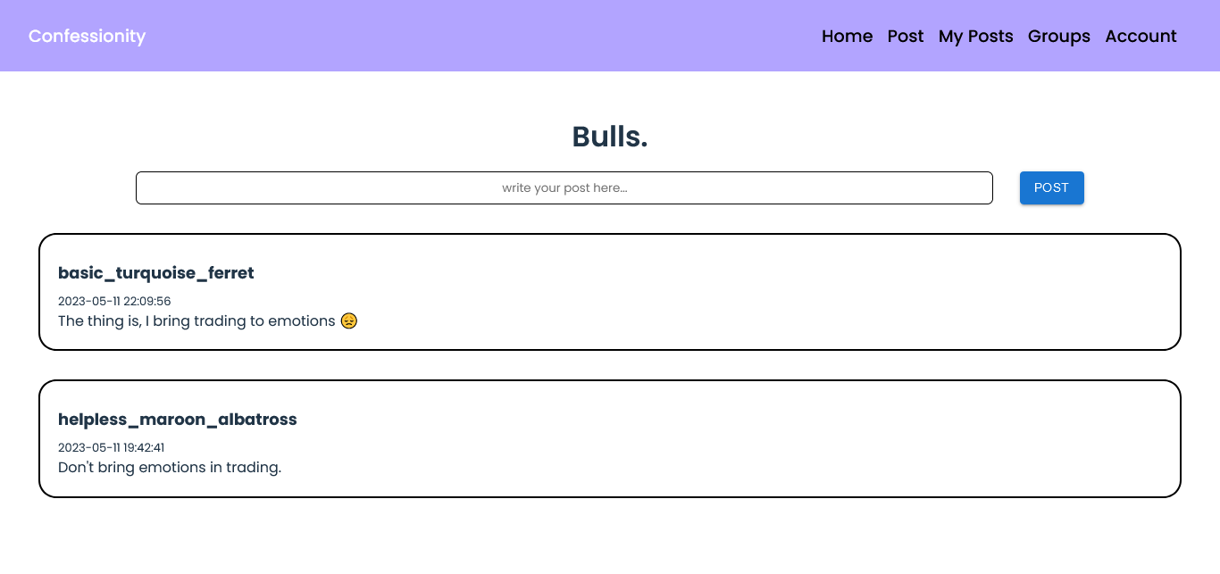
Specific Group page - users can post in their choice of group

Slide 20
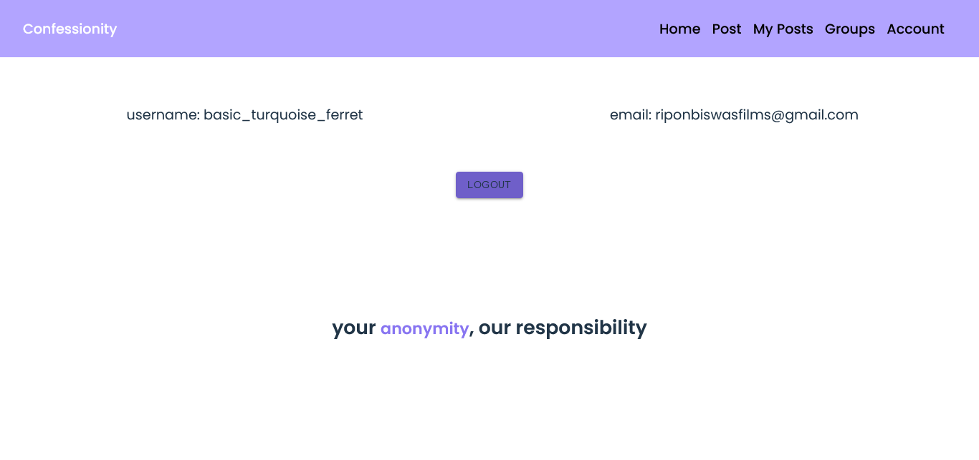
Accounts page - users’ account details and they can logout as well

Slide 21
06
Future Scopes
To develop our own sentiment analysis sytem, to remove API dependentation for analysing users posts or comments
Provide users with useful links and phone no. where thry can seek professional help and advice
Create a feature where professional psychiatrists can post their gig
A motivation or quote of the day feature

Slide 22

Thank You!

